Slide 1
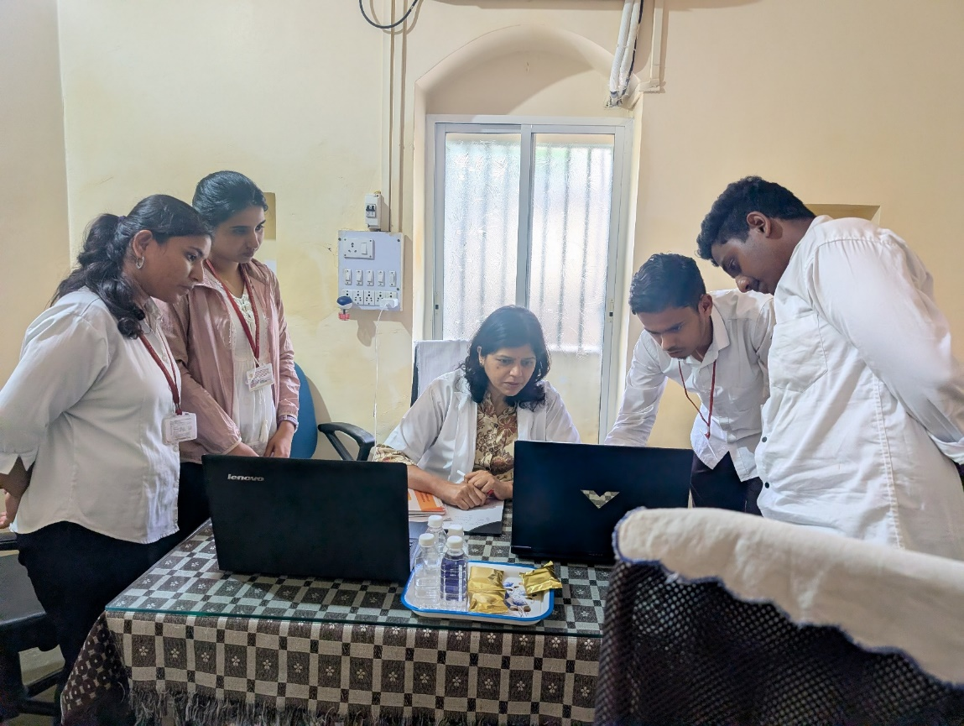
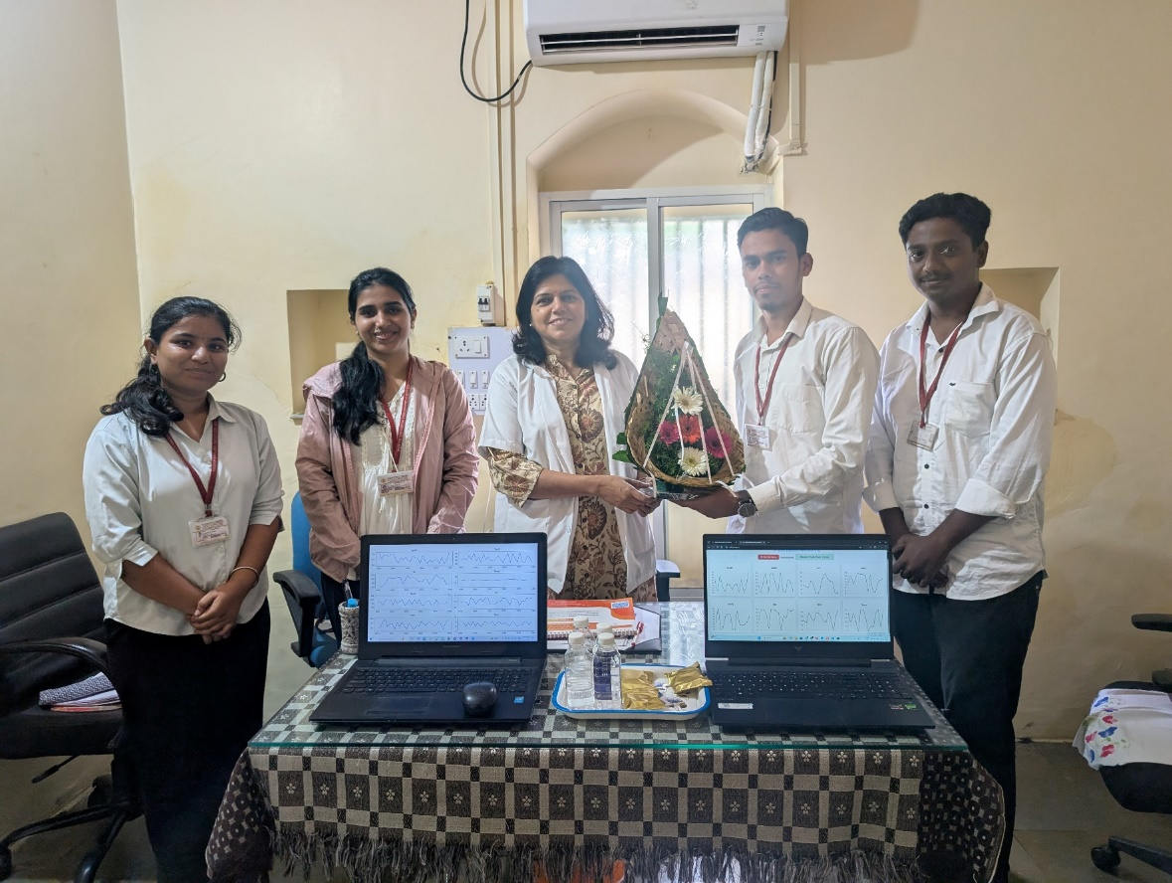
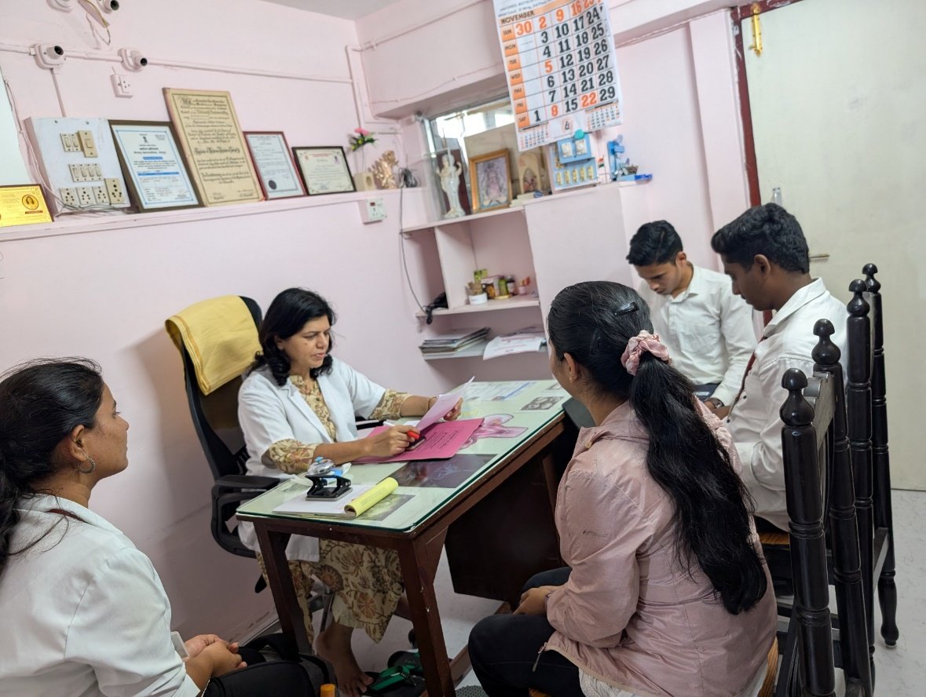
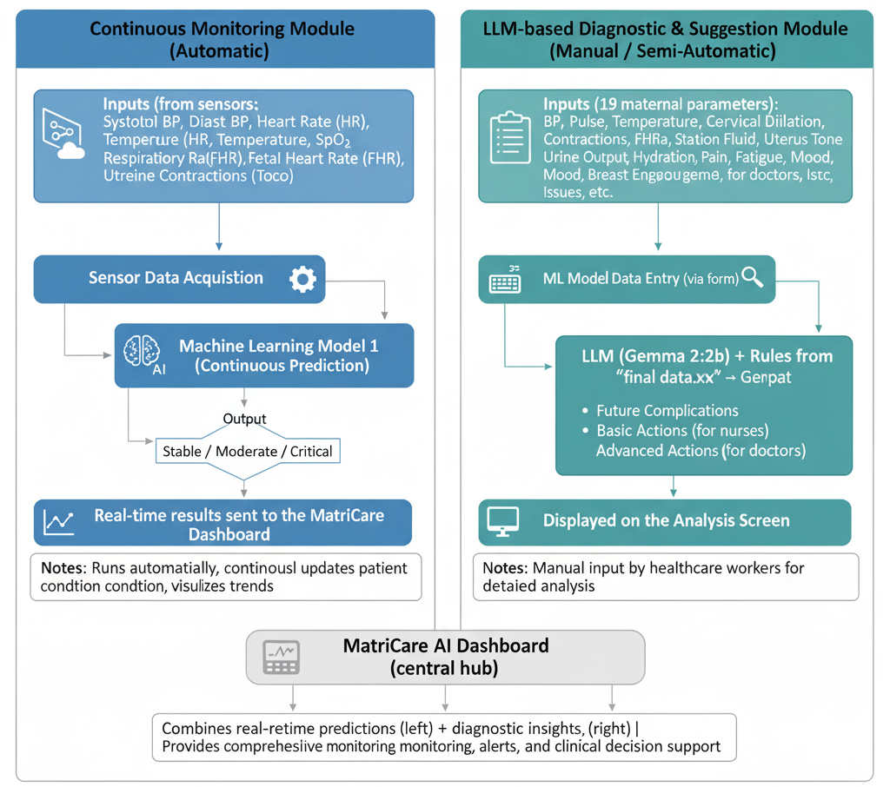

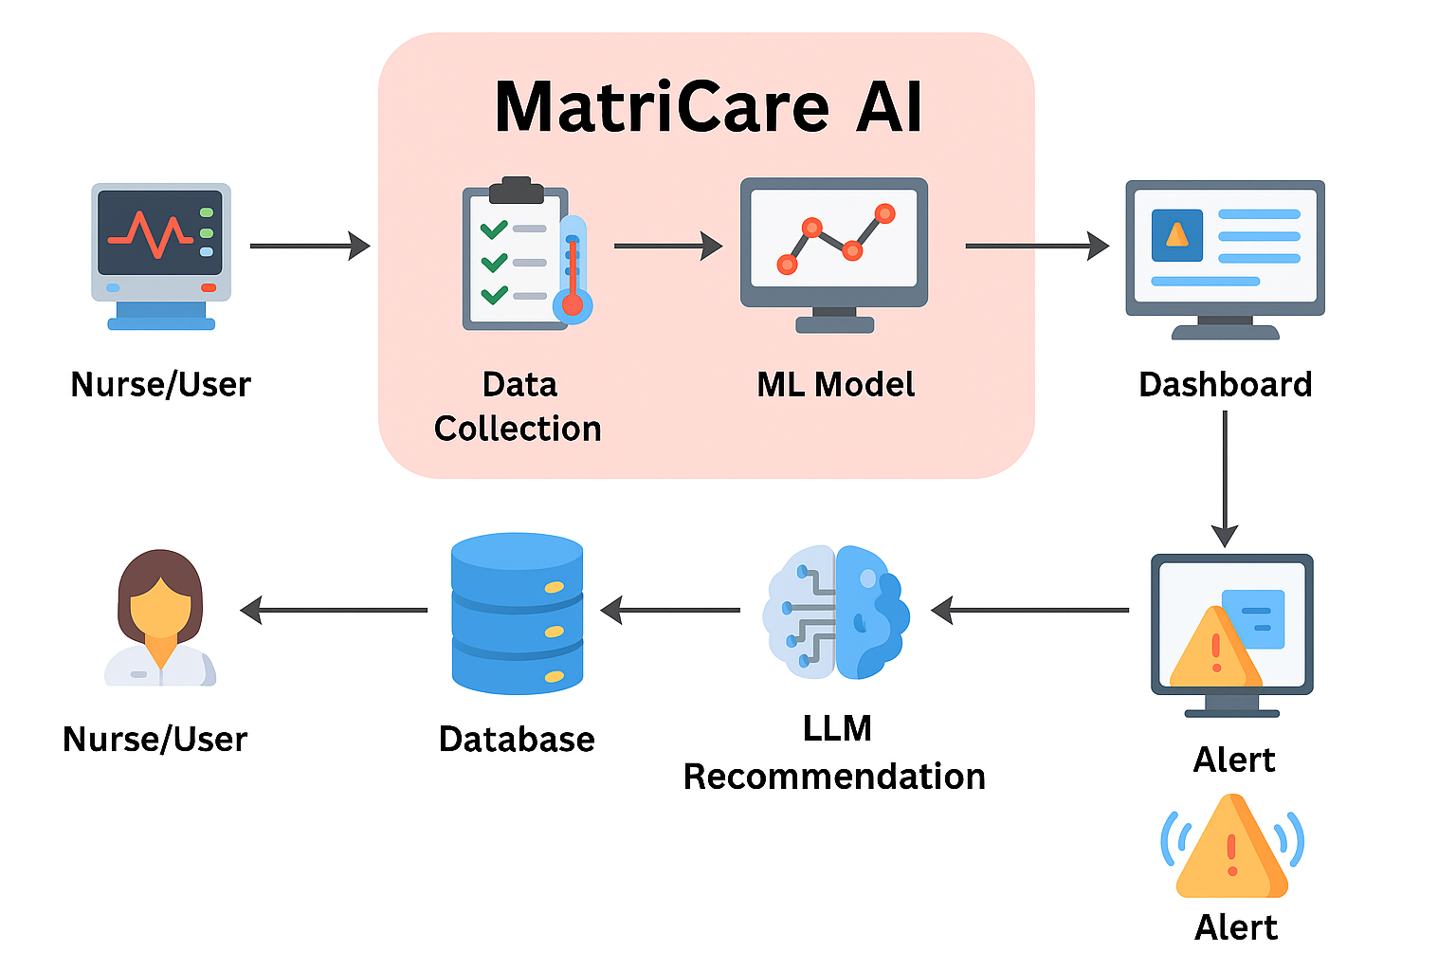
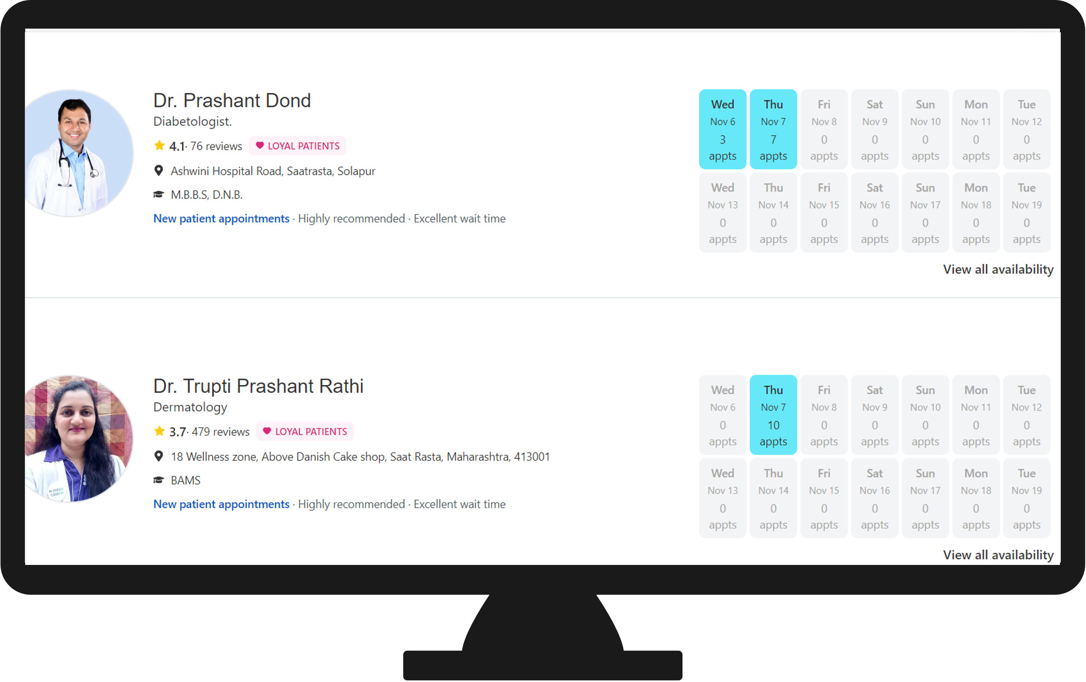
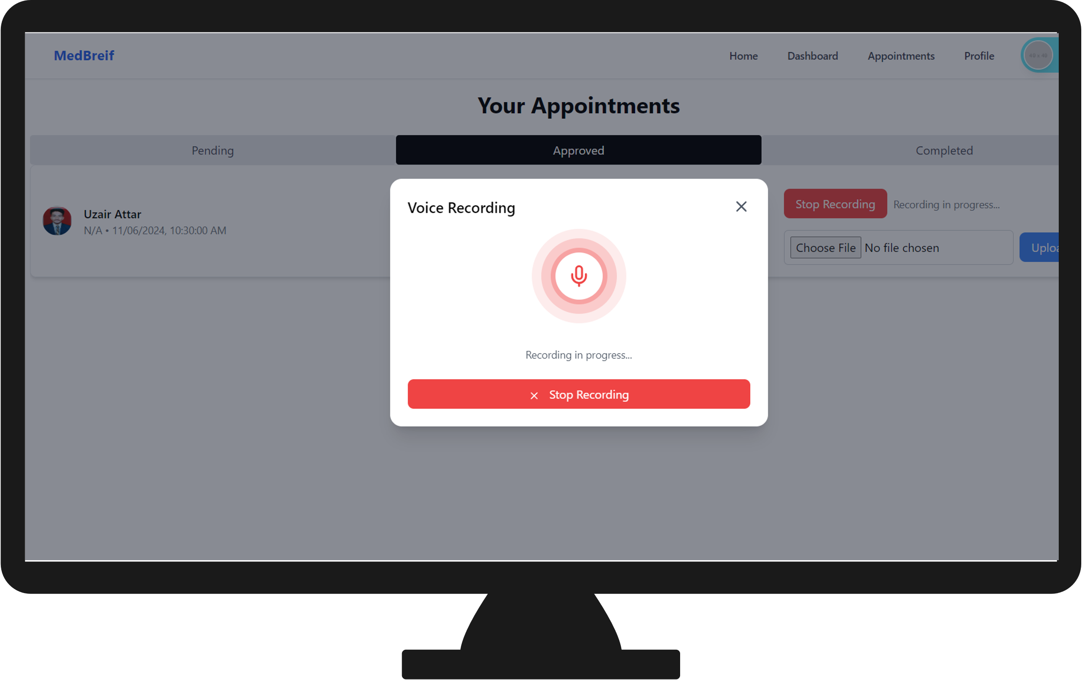
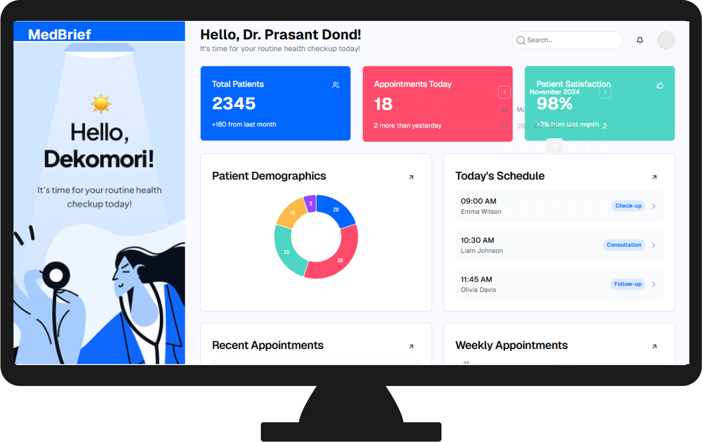
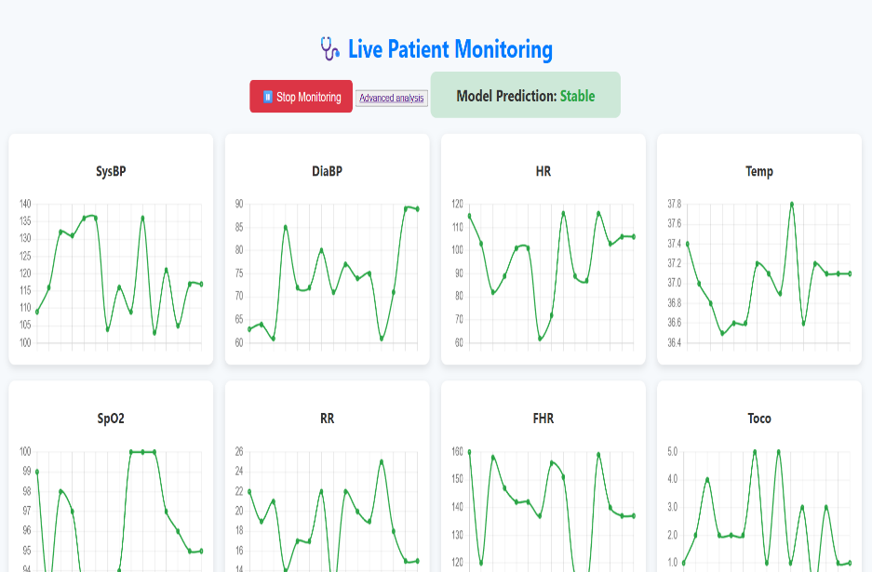
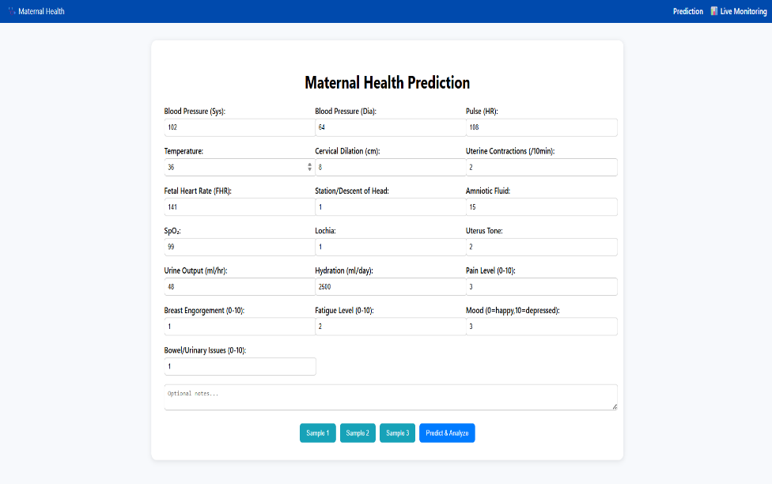
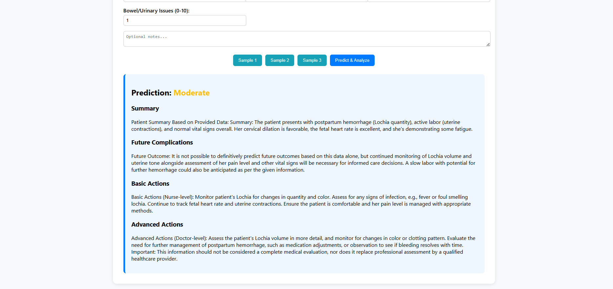




Aavishkar Maharashtra State Inter-University Research Convention
Category: Medicine and Pharmacy Code No.: Level: UG
MatriCare AI – AI Based Prediction of Labour related Complications
Introduction
Survey
MatriCare is an intelligent maternal health monitoring and recommendation system designed to support healthcare professionals during labour. The platform enables continuous tracking of vital parameters such as blood pressure, heart rate, oxygen saturation, temperature, and uterine contractions, ensuring real-time assessment of maternal and fetal well-being. A machine learning model classifies the patient’s condition as Stable, Warning, or Critical, while an integrated language model generates personalized recommendations for timely medical intervention. By combining automated monitoring with intelligent decision support, MatriCare enhances clinical efficiency, reduces human error, and promotes safer childbirth outcomes.
A survey conducted at Ramkrishna Hospital, Banshankri Hospital, and nearby maternity centers in Solapur showed that most still follow manual monitoring with limited automation. Doctors and nurses highlighted the need for a system to track vitals, predict risks, and give AI-based recommendations. These findings confirmed the importance of developing MatriCare AI to enhance efficiency and accuracy in labour monitoring.
Use Case Diagram
Website
Workflow Flow Diagram
Scan to Learn More
Explore how MatriCare AI uses continuous monitoring and intelligent analysis to predict pregnancy complications and support healthcare professionals.
Key Features
Conclusion
Future Scope
Real-time Monitoring
Tracks vital signs like blood pressure, heart rate, oxygen level, and contractions continuously.
MatriCare represents a step forward in intelligent maternal care, transforming traditional labour monitoring into a proactive, data-driven process. By combining continuous health tracking with AI-based prediction and language-powered recommendations, it bridges the gap between technology and clinical expertise. The system promotes faster, more reliable decision-making while reducing dependency on manual observation. With future expansion toward real-time IoT integration and adaptive recommendations, MatriCare is poised to become a vital companion in modern obstetric care, ensuring safer outcomes for mothers and newborns alike.
Voice Assistant: Integrate a smart voice assistant for hands-free interaction, enabling verbal guidance,
AI Risk Prediction
Uses machine learning to classify patient condition as Stable, Warning, or Critical.
Multilingual Support: Add regional language options for wider accessibility in diverse healthcare settings.
Smart Recommendations
LLM-based system provides quick, personalized guidance for timely action.
Cloud Connectivity: Enable cloud-based data storage for remote monitoring and analytics.
Simple Interface
Easy-to-use design for smooth operation during labour monitoring.
Mobile Application: Develop a companion app for doctors and nurses to access live patient updates.

